Slide 1
F# @ SkillsMatter Progressive Tutorials

Slide 2
Succeeding with Functional-First Languages in Industry
Don Syme
Microsoft

Slide 3
Some technical talks….
PDC 2008
An Overview of F# 2.0
channel9.msdn.com/blogs/pdc2008/tl11
//BUILD 2011
F# 3.0: Data, Services, Web, Cloud, at your fingertips
channel9.msdn.com/Events/BUILD/BUILD2011/SAC-904T

Slide 4
Today: Some Simple Observations About Quantitative Finance Calculation Engines Trading Platforms Recommendation Engines … with F# (and associated technologies)

Slide 5
Will focus on the business perspective and its correspondence to the technical features of F# Based on informal observations of many F# adoptions, nearly all successful many of the same lessons hold for OCaml, Erlang, Haskell, Scala, …

Slide 6
When talking about the business perspective, I will use a standard marketing methodology for selling “complex” products.
S
P
Situation
Problem
I
Implication
N
Need
TM
“SPIN Selling”, Rackham

Slide 7
Part 1 – Business Situation? Business Problems? Business Implication? Business Needs?

Slide 8
The Recurring Business Situation
“I lead a team developing…”
Financial Models
Trading Platforms
…
Insurance Calculation Engines
Bio-informatics Algorithms
Algorithmic Trading Systems
Online Recommendation Engines

Slide 9
The Recurring Business Situation
“I lead a team developing…”
Analytical Components
…
Analytical Components
Analytical Components
Analytical Components
Analytical Components

Slide 10
The Recurring Business Problems
Time to Market
Efficiency
Correctness
Complexity
for analytical components

Slide 11
Is Time to Market a Problem? Late Models → Missed Business Opportunities, Missed Regulatory Requirements Late Services → Missed Markets Late Products → Business Failure
Notes:
“Take a moment to stop and think about the ramifications of time-to-market problems through software delays in analytical components for QF, FE, Trading and Calculation Engines more broadly”

Slide 12
Is Correctness a Problem? Buggy Models → Incorrect Values/Risks/Trades Buggy Services → Reputation Loss Buggy Products → Lost Customers
Notes:
“Take a moment to stop and think about the ramifications of correctness problems through software delays in analytical components for QF, FE, Trading and Calculation Engines more broadly”

Slide 13
Is Efficiency a Problem? Slow Models → Out-of-date Valuations/Risks Slow Services → Can’t Scale Out Slow Products → Customer Complaints
Notes:
“Take a moment to stop and think about the ramifications of efficiency problems through software delays in analytical components for QF, FE, Trading and Calculation Engines more broadly”

Slide 14
Is Complexity a Problem? Intractable Models → No valuations Intractable Services → Failed Projects Intractable Products → No product
Notes:
We don’t talk enough about the software we were never able to write. We don’t talk enough about why good analytical programmers leave their jobs.

Slide 15
The Recurring Business Problems
Time to Market
Efficiency
Correctness
Complexity
for analytical components

Slide 16
What’s the Need? Analytical programmers delivering correct, efficient components in the enterprise, on-time This is the set of problems that F# helps solve

Slide 17
Part 2 - But why? The Observations

Slide 18
Observation #1 At the core of every functional-first language is this: simple, correct, robust code for complex problems

Slide 19
Observation #2 A highly interoperable language allows rapid, non-intrusive deployment and integration of components Functional code is a part of a larger solution. Your code can be rapidly integrated and deployed.

Slide 20
Observation #2 cont. Interoperable languages remove entire phases from the analytical software development process No R → C# No Mathematica → C++
Notes:
Functional programming tools empower when combined with other technologies

Slide 21
Observation #3 Strongly-typed functional languages maintain efficiency comparable to C# and Java, and sometimes C++

Slide 22
Observation #4 Strongly-typed functional languages help analytical programmers tackle more complex problems

Slide 23
Recap – How Functional-first Helps
Simple, correct, robust code
Interoperability eliminates entire phases
Strong-typing gives efficiency
Analytical developers empowered to solve complex problems

Slide 24
Part 2 - But why? The Examples and Case Studies

Slide 25
Example #1 (power company)
I have written an application to balance the national power generation schedule … for an energy company.
...the calculation engine was written in F#.
The use of F# to address the complexity at the heart of this application clearly demonstrates a sweet spot for the language … algorithmic analysis of large data sets.
Simon Cousins (Eon Powergen)
http://fsharp.net

Slide 26
Example #1 (power company)
Time to Market
Efficiency
Interoperation ... Seamless. The C# programmer need never know.
Units of measure … a huge time saver...it eradicates a whole class of errors…
Exploratory programming …Working with F# Interactive allowed me to explore the solution space more effectively.
Unit testing …a joy to test. There are no complex time-dependent interactions to screw things up….
Parallelism …The functional purity ... makes it ripe for exploiting the inherent parallelism in processing vectors of data.
Code reduction… … vectors and matrices…higher order functions eat these for breakfast with minimal fuss, minimal code. Beautiful.
Lack of bugs… Functional programming can feel strange. .. once the type checker is satisfied that’s often it, it works.
Correctness
Time to Market
Time to Market
Correctness
Correctness

Slide 27

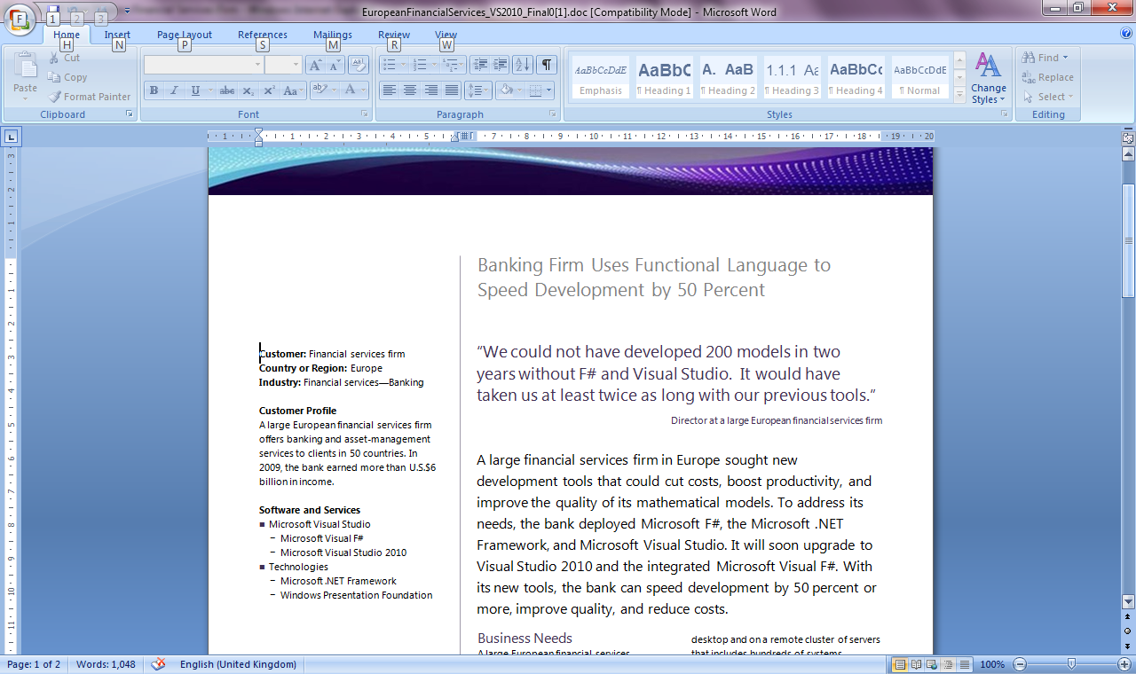
Example #2/#3: F# in Finance
Time to Market
Correctness
Time to Market
Correctness
Efficiency
http://fsharp.net

Slide 28
Example #3: F# in Insurance
I work for a large actuarial company... …Despite adopting Agile/Scrum …the usual delays, complications and sometimes …failures.
We used F#, and quickly created a system which would perform the necessary calculations highly efficiently, in parallel, and with a perfect match to the spreadsheet results.
All of the advantages which are commonly touted for F# do play out in practice. Immutability, Easy Parallelisation, Expressiveness, Testability, Conciseness, Flexibility, Productivity
[ Company name omitted ]
Time to Market
Efficiency
Correctness

Slide 29

Example #4: Finance trading platform
F# + C# for Trading Front End
Leverage F#’s features:
- extensive type system
- asynchronous workflows, agents and immutable types
- rich pattern matching and parser support
“Experienced F# developers regularly solve problems in days that would take weeks using more traditional languages…solving complex problems in an elegant and highly maintainable manner”
Time to Market
Complexity

Slide 30
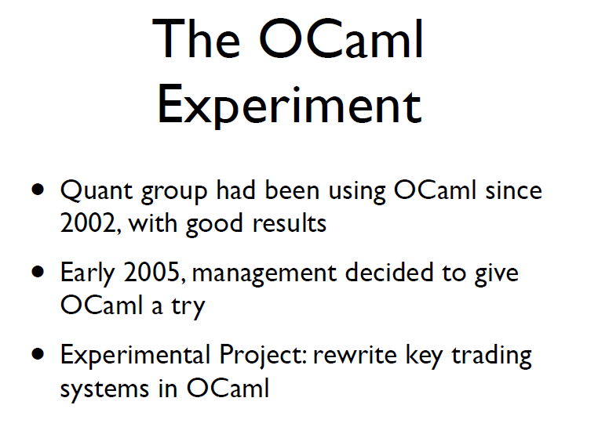
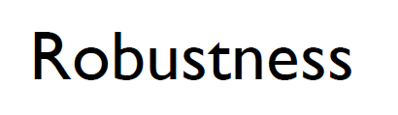
Example #5: OCaml @ Jane St
source: http://www.janestcapital.com/yaron_minsky-cufp_2006.pdf

Slide 31
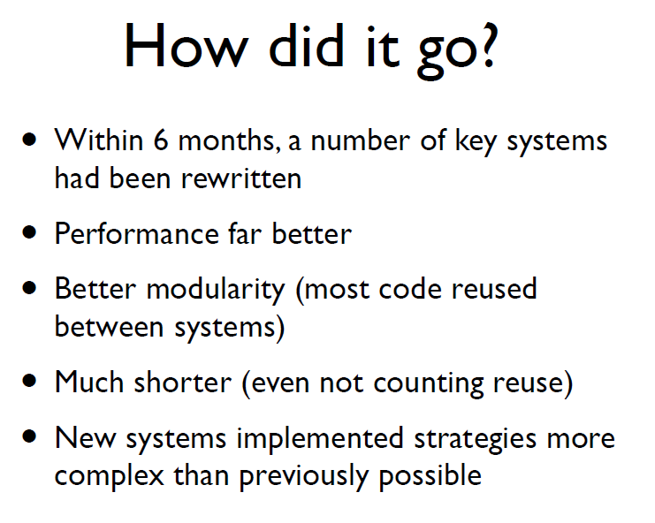
Example #5: OCaml @ Jane St
Efficiency
Solve complex problems
source: http://www.janestcapital.com/yaron_minsky-cufp_2006.pdf

Slide 32
Example #6: F# in Biotech
Efficiency
...F# rocks - building algorithms for DNA processing and it's like a drug. 12-15 at Amyris use F#... A complete genome resequencing pipeline with interface, algs, reporting in ~5K lines and it has been incredibly reliable, fast and easy to maintain.. A suffix tree in 150 lines that can index 200,000 bases a second ;)
F# v. Python: F# has been phenomenally useful. I would be writing a lot of this in Python otherwise and F# is more robust, 20x - 100x faster to run and faster to develop.
Units of measure: I started labelling the coordinates as one or zero based and immediately found a bug where I'd casually mixed the two systems. Yay F#!
Darren Platt, Amyris BioTechnologies
Correctness
Time to Market
Correctness

Slide 33
Example #7: F# in Advertisement Ranking & Rating @ Microsoft
Around 95% of the code in these projects has been developed in F#.
F# allowed for rapid development of prototypes, and thus also rapid verification or falsification of the underlying mathematical models.
Complex algorithms, for example to compute Nash equilibria in game theory, can be expressed succinctly.
Units of measure reduced the chance of errors dramatically: Prices, probabilities, derivatives, etc. can already be kept apart at compile time.
Time to Market
Taming Complexity
Correctness

Slide 34
Summary – The Data Agrees
Simple, correct, robust code
Interoperability improves time-to-market
Strong-typing gives efficiency
Analytical developers empowered to solve more complex problems

Slide 35
Part 3 – F# in Practice

Slide 36
Simplicity: Functions as Values
abstract class Command {
public virtual void Execute();
}
abstract class RoverCommand : Command {
protected Rover Rover { get; private set; }
public RoverCommand(MarsRover rover) {
this.Rover = rover;
}
}
class BreakCommand : RoverCommand {
public BreakCommand(Rover rover)
: base(rover) { }
public override void Execute() {
Rover.Rotate(-5.0);
}
}
class TurnLeftCommand : RoverCommand
{
public TurnLeftCommand(Rover rover)
: base(rover) {
}
public override void Execute() {
Rover.Rotate(-5.0);
}
}
OO
F#
type Command = Command of (Rover -> unit)
let BreakCommand =
Command(fun rover -> rover.Accelerate(-1.0))
let TurnLeftCommand =
Command(fun rover -> rover.Rotate(-5.0<degs>))

Slide 37
Simplicity: Functional Data
C#
let swap (x, y) = (y, x)
let rotations (x, y, z) =
[ (x, y, z);
(z, x, y);
(y, z, x) ]
let reduce f (x, y, z) =
f x + f y + f z
Tuple<U,T> Swap<T,U>(Tuple<T,U> t)
{
return new Tuple<U,T>(t.Item2, t.Item1)
}
ReadOnlyCollection<Tuple<T,T,T>> Rotations<T>(Tuple<T,T,T> t)
{
new ReadOnlyCollection<int>
(new Tuple<T,T,T>[]
{ new Tuple<T,T,T>(t.Item1,t.Item2,t.Item3);
new Tuple<T,T,T>(t.Item3,t.Item1,t.Item2);
new Tuple<T,T,T>(t.Item2,t.Item3,t.Item1); });
}
int Reduce<T>(Func<T,int> f,Tuple<T,T,T> t)
{
return f(t.Item1) + f(t.Item2) + f (t.Item3);
}
F#

Slide 38
Lesson: Combining with the right tools is key

Slide 39
Examples
A quant model
A trading engine
F# + existing C++ components
A calculation engine with GPU execution
F# + FCore Math
A scalable web service
Data Services + F# + ASP.NET
A scalable big-data service
F# + Hadoop + ServiceStack
A Web 2.0 startup
F# (Server) + SQL Server + DataFeeds + ASP.NET + F# (WebSharper) + HTML5
Oracle + F# (Server) + F#/C# (Silverlight)

Slide 40
F# in Practice: More Lessons
Build capabilities in functional-first techniques
Training is key
Trial on specific components, prototyping, testing and exploration
✗ Don’t rewrite stable, working components in F#
✗ Always reuse C++ high-performance components.

Slide 41
Recent Developments in F# @ Microsoft
F# 3.0
F# + Azure
F# + Azure Hadoop
F# + Azure Cloud Numerics
queries, powerful data integration, better tooling, portable libraries
for scalable service programming
for scalable big-data programming
for scalable math programming

Slide 42
Some Other Developments in F#
F# + WebSharper
F# + FCore
F# + m-brace
F# + …
very powerful cross-platform HTML5 web/mobile programming
for statistical/math programming + GPU
a cloud-execution framework
many other { open-source, .NET, C#, … }

Slide 43
In Summary – Functional-First Languages
F.F.
Rapid, correct development
Parallelism a bonus
Functional-first delivers real value
Recruitment strategy

Slide 44
In Summary – F#
F#
Ready for supported use in VS2010 + VS11
Code correctness, efficiency and interoperation in the modern enterprise
A bright future ahead for web/data/cloud
Improved time-to-market for analytical components

Slide 45
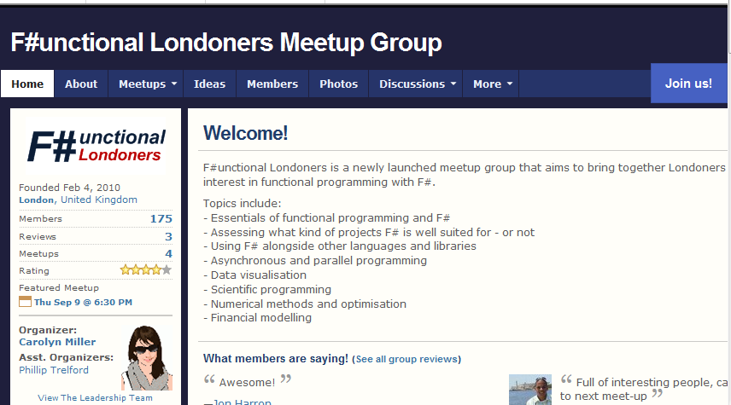
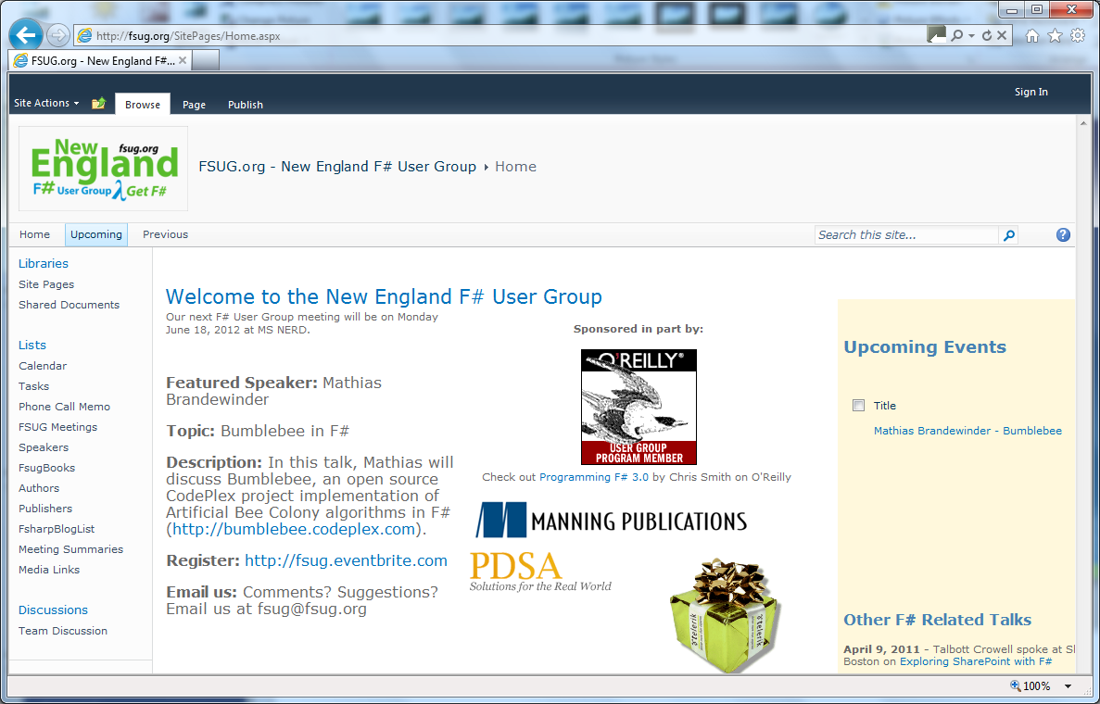
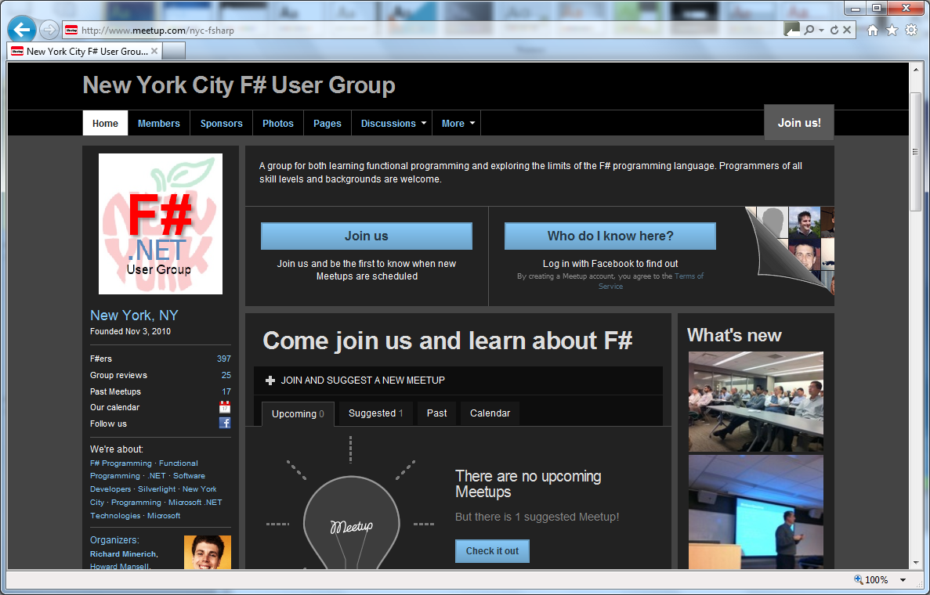
http://meetup.com/FSharpLondon

Slide 46
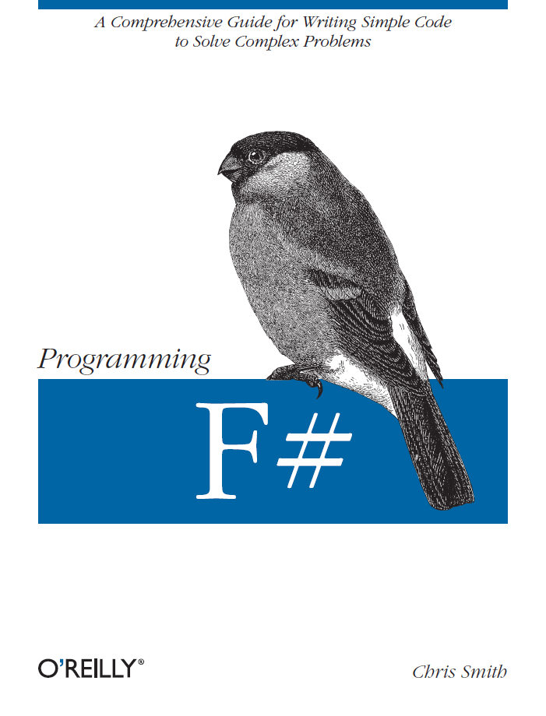
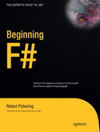
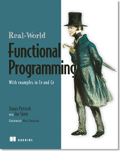
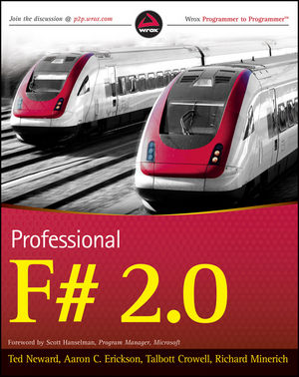


Some Books about F#
Visit www.fsharp.net

Slide 47

Learn more at http://fsharp.net Questions?

